Slide 1




The E5 DTP Edinburgh Earth, Ecology and Environment Engagement Doctoral Training Partnership
Richard Essery – E5 DTP Director
Nicola Drago Ferrante – E5 DTP Manager
Lokesh Jain – 2022 student cohort
Sarah Schubert – 2024 student cohort
This session will begin at 14:00 GMT

Slide 2


Audio check
Can you hear the presenter talking?
Please type yes or no in the “Text chat area”
If you can’t hear
Check the Audio settings in Teams
Try signing out and signing back into the session
Type into the chat box and a moderator will try to assist you

Slide 3
Asking questions
We will answer questions after the end of the formal presentations
Type questions in the “Text chat area”
If you would like to ask your question verbally, use the “Hand raise icon” to let us know
Unmute your microphone when we call on you to ask your question
Please mute your microphone and lower your hand once your question has been answered

Slide 4
The E5 DTP
Edinburgh Earth, Ecology and Environment Engagement Doctoral Training Partnership
Richard Essery, E5 DTP Director

Slide 5
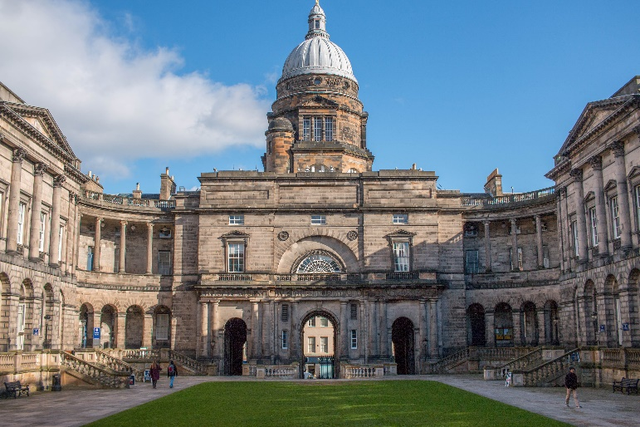
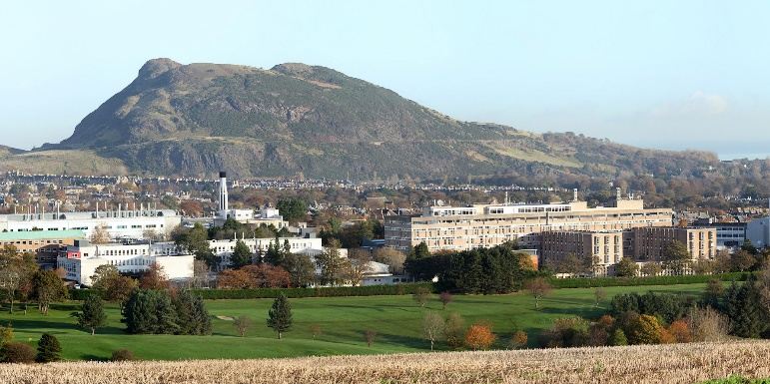
The University of Edinburgh
Founded 1582
29,765 undergraduate, 13,550 taught postgraduate and
6,425 postgraduate research students from ~156 countries
in 2022-2023
3rd in the UK and 22nd in the world
– QS World University Rankings 2024
5th in the UK and 30th in the world
– THES World University Rankings 2024

Slide 6
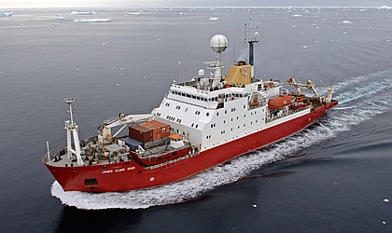
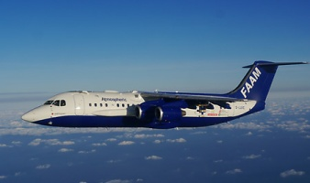

The Natural Environment Research Council
NERC advances the frontiers of environmental research by
commissioning world-leading research, infrastructure and training
15 DTPs awarded in phase 1: 2014-2018 intakes
17 DTPs awarded in phase 2: 2019-2024 intakes

Slide 7
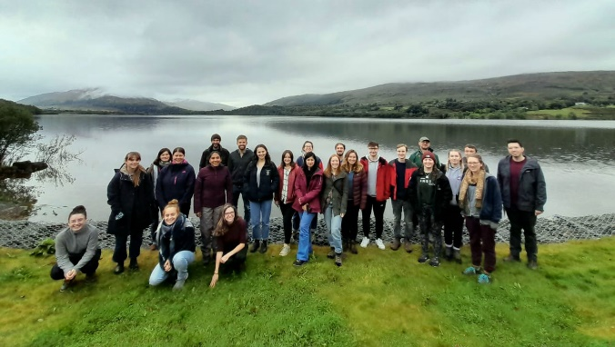

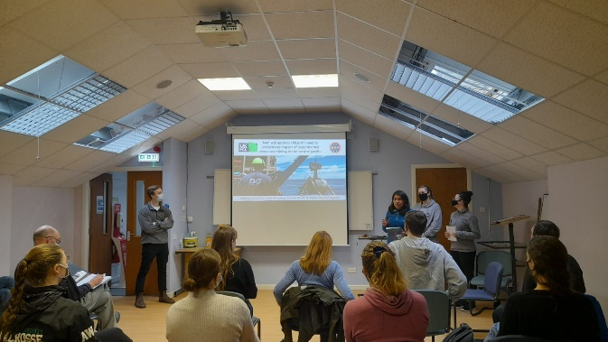
The E3 and E4 DTPs
E3:
117 starts in 2014-2018
E4:
The joint largest NERC DTP, and the largest geographical focus
PhD starts: 2020 24
2021 25
2022 23
2023 32
2024 25
– a vibrant and active postgraduate community

Slide 8
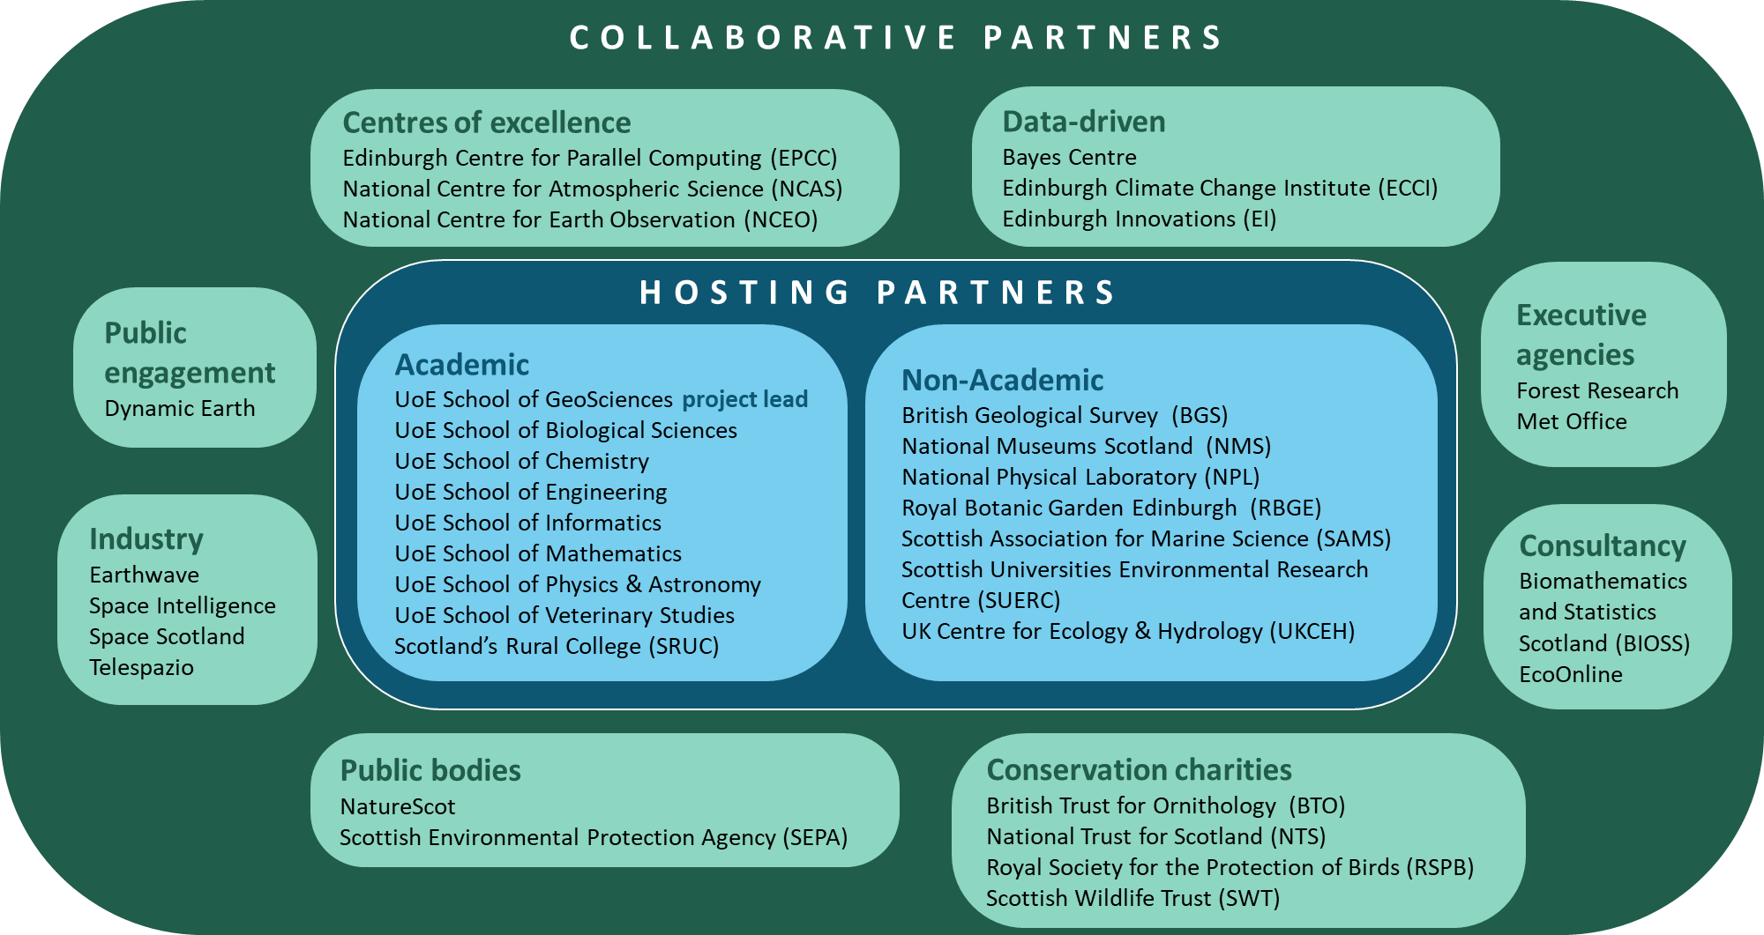
E5 DTP partners
Notes:
SAC (The Scottish Agricultural College) is an innovative, knowledge-based organisation, supporting the development of land-based industries and communities through our･specialist research and development resources･education and training provision･expert advisory and consultancy servicesOur work is wide ranging but there is a particular emphasis on agriculture and related sciences, rural business development and management, food chain quality and safety, and rural resource and environmental management.Through our associate company, SAC Commercial Ltd, we can provide a wide range of services to individuals, small and medium size enterprises, corporate clients, local and regional authorities, and government agencies and departments.Certain of our services in Scotland are assisted by the Scottish Executive Environment and Rural Affairs Department through its Grant-in-aid programme as part of the national provision for research and rural advisory services.SAC's Scotland-wide NetworkOur three main campuses are at Aberdeen, Ayr and Edinburgh, and there are 23 local advisory offices, eight veterinary centres and five research farms.Much of our work is in partnership with government departments, levy boards, other academic and research organisations, and local authorities.Commitment to ServicesWe are committed to providing the highest levels of service to all of our clients. See our 'Standards of Service'.
ur scientific programme has two key funding elements:･A Core Strategic programme funded from the UK government's Science Budget and administered through the Natural Environment Research Council (NERC). The programme entails long-term surveying, monitoring and databasing, underpinned by applied research. ﾊ･A Commissioned programme undertaken for clients but with an essential aim that it should enhance the public-good objectives of the Core Strategic programme.Understanding the Earth and the processes that shape it is fundamental to the successful development and sustainable management of our planet. The evolution of the Earthﾕs crust over geological time has resulted in diverse, often beautiful, landscapes formed by earthquakes, oceans, fire and ice. These landscapes are also a source of mineral wealth and water, a base for engineering projects and a receptacle for our waste. In order to safeguard the well-being of the planet, we need geological data and expertise to help us understand the complex interactions between the Earthﾕs shallow subsurface, water, air and living things.

Slide 9
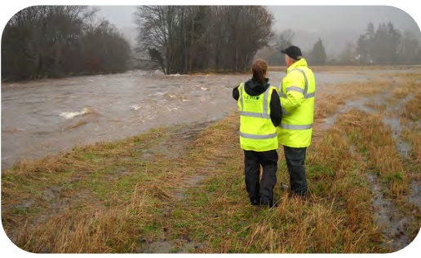

PhD activities
independent research to make a significant contribution in a field of study (submission of a PhD thesis by end of funding)
regular meetings and collaboration with supervisors
attending research seminars and group meetings
cohort and individual training
Professional Internship Placement (3 months)
Optional:
up to 60 hours/semester paid tutoring and demonstrating
outreach activities (schools, science festivals, blogging, …)

Slide 10
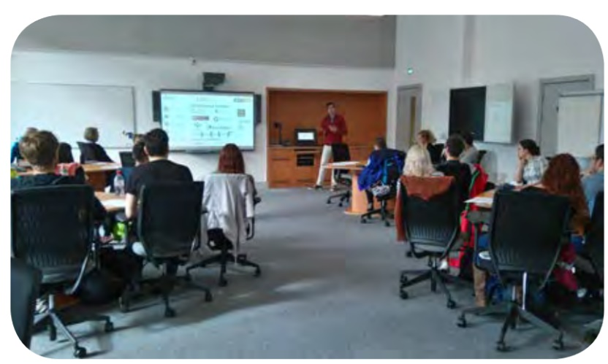
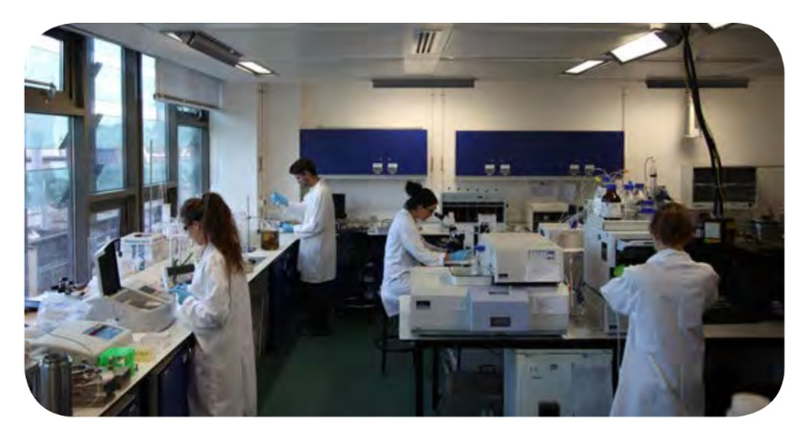
E5 DTP training and cohort building
25 days cohort and 25 days individual training over
the course of a PhD, based on four pillars:
training needs analyses
core professional skills
advanced research training
peer learning (e.g. Coding Club)

Slide 11






Student Support Services
University Student Support Services:
Health
Wellbeing and mental health
Counselling
Sport and Exercise
Disability and Learning and Support
Student Immigration
Careers
Institute for Academic Development
Accommodation
Student Finance
Childcare
The Advice Place by EUSA (Edinburgh University Student Association)

Slide 12
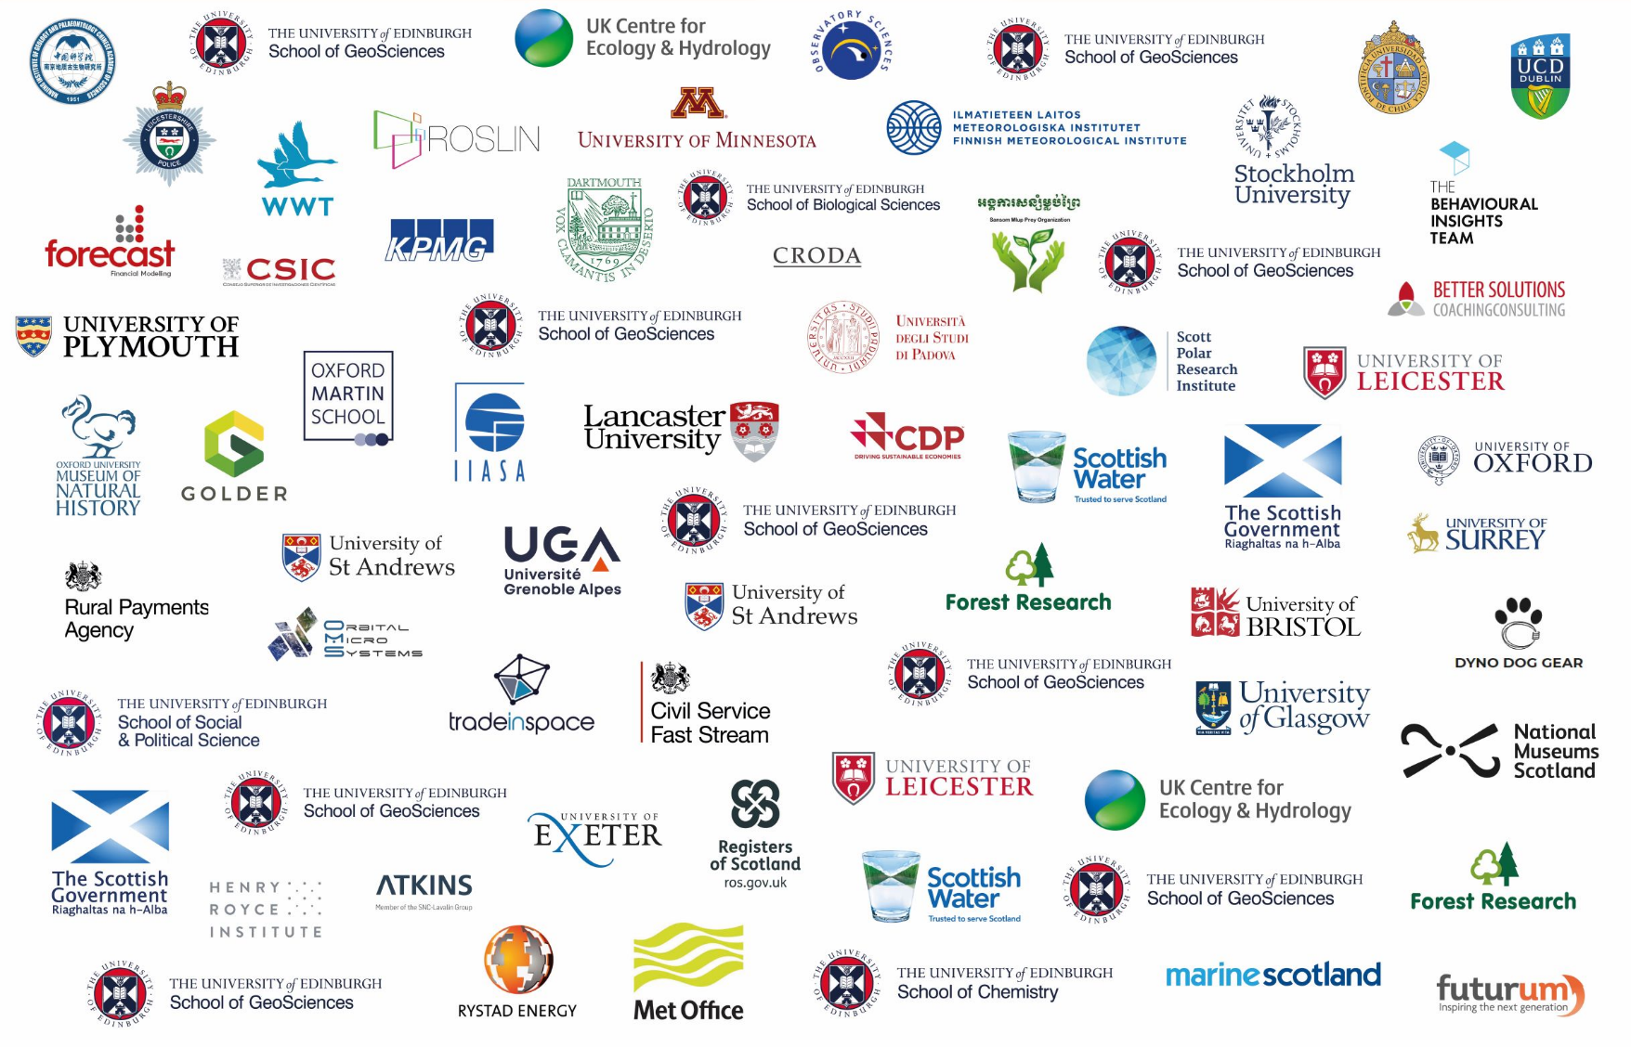
Where have our students gone on to?

Slide 13
Highlights from DTP alumni
Publications
Presenting at International conferences
The PIP (Professional Internship)
Training workshops, summer schools
Tutoring and Demonstrating
Winning / being nominated for awards
Independent fieldwork
Research visit and collaborations
Participating in Public engagement activities (Science Festivals e.g.)
Laboratory work
https://www.ed.ac.uk/e4-dtp/people/dtp-alumni

Slide 14


E5 DTP Funding details 2025 How to apply
Application deadline is 6th January 2025 for entry in September 2025
Fully-funded studentships – 4 years
Stipend at UKRI standard rate (2024/2025: £19,237)
Fees (for 4 years - Home and International fees)
Research Costs (minimum £3,450)
CASE studentships
Additional research support and possible costs to support the project.
For the full 4 year stipend, you will need to undertake a Professional Internship Placement (PIP) of 3 months (this does not extend your end date).
Expectation to submit thesis by the end of the funding.
International Fees Covered
The University of Edinburgh will cover the difference between the home fees (paid by E5) and the international fees. International students will not be expected to find alternative funding sources to cover this gap.

Slide 15
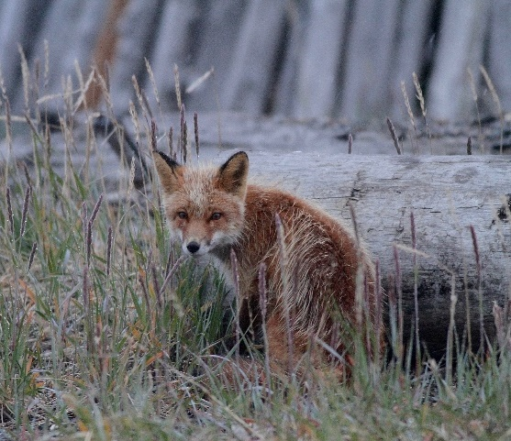
Application deadline is 6th January 2025 for entry in September 2025
E5 DTP Eligibility Criteria 2025
UKRI Eligibility Criteria
All applicants, regardless of their nationality and country of residence, are eligible to apply.
All appointees, regardless of their nationality and country of residence, will receive a fully-funded studentship.
UoE fees status categories
Home fees:
UK nationals, EU students with UK pre-settled status or settled status, non-EU students who have indefinite leave to remain, some Irish nationals
AND who comply with the 3-year UK/EEA residency immediately before the start of the degree (UK or Ireland residency for Irish nationals)
International fees: all other categories
Exceptions: refugees, children of UK nationals, legitimate absence from the UK for UK nationals
Cap on international students number
E5 can recruit a maximum of 7 international students per year.

Slide 16
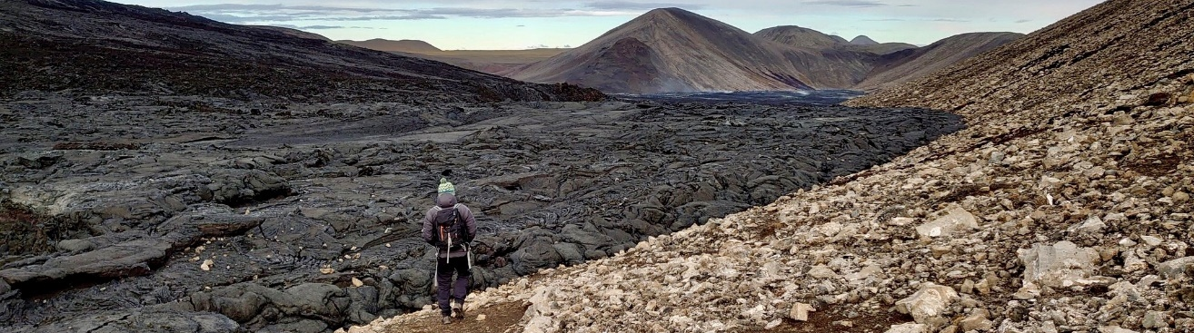
E5 DTP Entry Requirements 2025
Application deadline is 6th January 2025 for entry in September 2025
Academic Eligibility Criteria
minimum of 2.1 undergraduate degree or equivalent
Relevant work experience and/or a Masters degree will be considered
A Masters degree is not a requirement for application to an E5 studentship
English language Requirements For non-native English speakers
Degree taught and assessed in English:
UG or PG
No older than 3.5 years at programme start
taught and assessed in English in a majority English speaking country (see list)
English Language Tests
IELTS Academic, TOEFL-iBT, CAE, CPE, Trinity ISE (see minimum marks required on web)
No older than 2 or 3.5 years

Slide 17
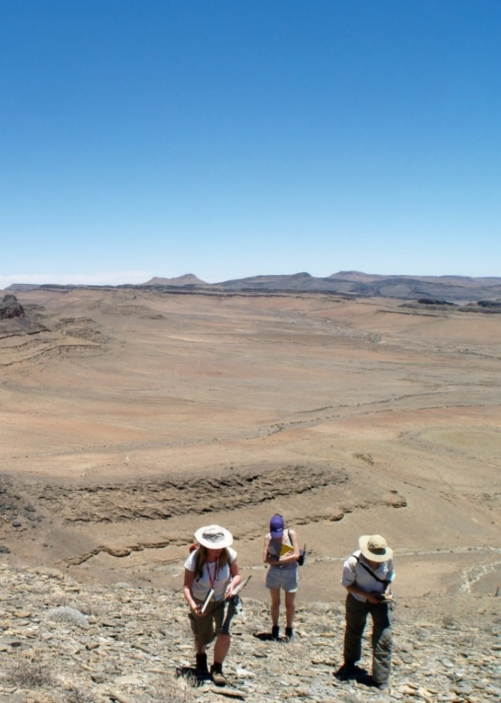
E5 DTP Projects 2025 entry
Application deadline is 6th January 2025 for entry in September 2025
Supervisor-led Projects
90 + projects advertised
Spanning a wide range of research areas within NERC-remit
Browse online at: E5 DTP Supervisor-led Projects | The University of Edinburgh
Once project identified, contact the main supervisor as early as possible to show interest and discuss your application
Student-led Projects
Find a supervisor willing to act as first supervisor
Supervisor submits the project on your behalf to our portal.
Apply to 1 project maximum overall

Slide 18
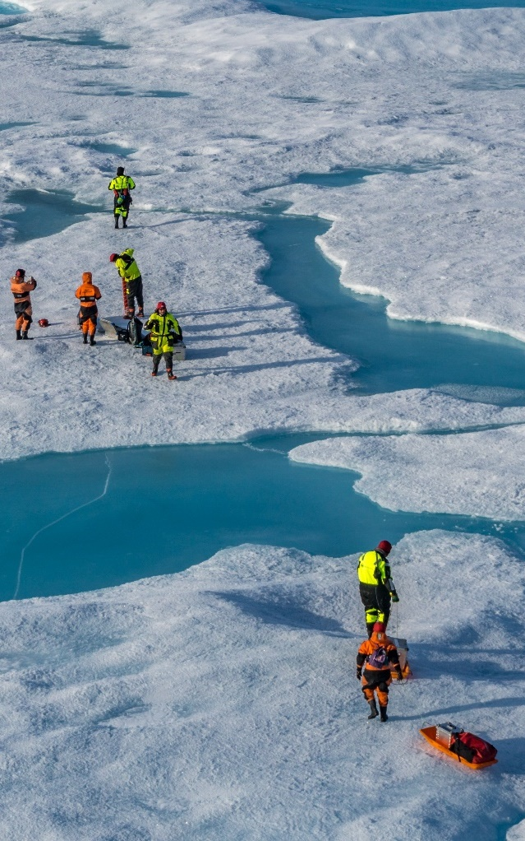
E5 DTP Widening Participation Scheme
Application deadline is 6th January 2025 for entry in September 2025
Applicants who would like to disclose information about belonging to one of our under-represented groups: declared disability, ethnic minority background, first generation to attend university, caring responsibilities, received/qualified for additional financial aid during your studies or other
Widening Participation Form
Optional
Confidential (not seen by supervisors or selection panels) – Widening Participation Panel
Disclosing special circumstances to the supervisors/selection panel if you wish to disclose information to the supervisors/selection panels in order for them to take it into consideration when assessing your application, please do so via the application form instead.

Slide 19
E5 DTP Application Material
Application deadline is 6th January 2025 for entry in September 2025
Compulsory Documents (for all candidates)
the E5 Application form
an Academic CV
Optional documents (depending on circumstances)
the Widening Participation Form
a valid English Language Test
the Equality and Diversity Form
all Higher Education Transcripts and certificates of UG and PG degrees obtained to date
a proof of your Immigration status

Slide 20
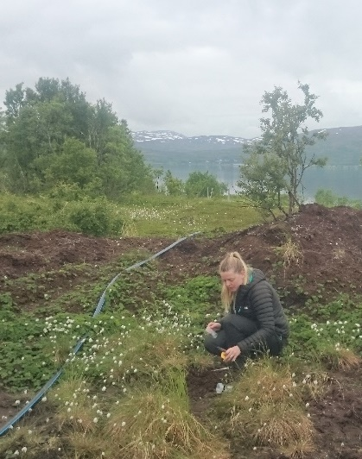
E5 DTP Application Process
Application deadline is 6th January 2025 for entry in September 2025
Prepare Application
Compulsory documents
Optional documents depending on circumstances
Contact Referees
Send the E5 reference form to 2 referees
Referees must upload their reference form via their referee portal by the application deadline
Submit application
Upload your application material on our application portal by the application deadline
Applications not including the compulsory documents by the deadline will be automatically rejected
Follow our application step-by-step guidance on our website.

Slide 21
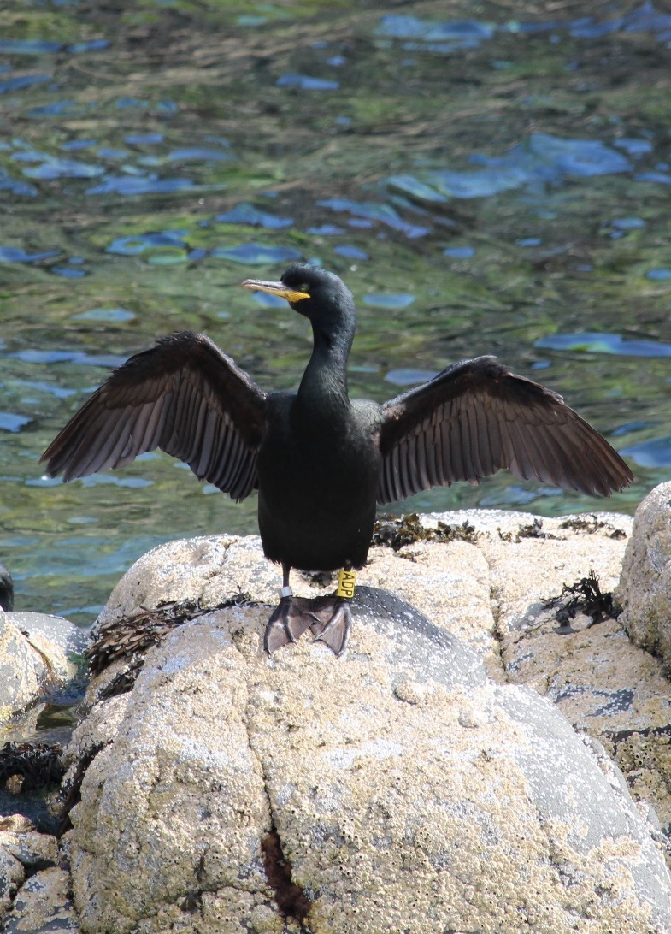
E5 DTP Online Applicant Portal
Application deadline is 6th January 2025 for entry in September 2025
The submission of your application material, including references, is via an online Applicant Portal.
Creating your Applicant Portal:
Click on “Apply for this project” at the bottom of the project proposal
Register with your name and email (or log in with Ease if UoE)
Check your email inbox for a link to your portal
Upload your documents when ready and by the deadline
Input your referees’ information – They will be emailed automatically with a link to submit their reference form.
There is no “submit” button, what you upload is what we see.
Use your Applicant portal (same link) to:
Check that your references have been submitted.
Replace any document already submitted (if necessary).
Change your referees information (if necessary).
Check any messages from the admission team
Applicant Portal Workflow available online

Slide 22

E5 DTP Assessment Process
Application deadline is 6th January 2025 for entry in September 2025
Applications are forwarded to the projects’ supervisors who select their preferred candidates.
The selected applications are shortlisted by three thematic E5 panels.
The top 60-70 applicants* are invited for interview and their performance evaluated by E5 panels.
Application and interview evaluations are combined to constitute the final ranking of applicants. The top ~20 applicants* are offered a studentship.
Applications are submitted and screened by the E5 DTP admission team.
APPLICATIONS EVALUATION
SCREENING
Supervisors selection
E5 Shortlisting panels
INTERVIEWS
OFFERS
International applicants must be pre-nominated by the lead supervisor
E5 Widening Participation Panel
May recommend additional applications for consideration
* Proportionally to the NERC cap for international students

Slide 23

E5 DTP Recruitment Timeline 2024/25
Application deadline is 6th January 2025 for entry in September 2025
Student-led Projects Submission Deadline | Initial contact latest – 16th December 2024
Application Deadline | 6th January 2025, noon GMT
Outcome sent via email by | 15th February 2025
Interviews | 25, 26 and 27th February 2025
First Offers sent by | 4th March 2025
2025 Universal NERC DTP acceptance of offers date (before which candidates are not obliged to accept any NERC-funded PhD offer) | Mid March 2025

Slide 24

E5 DTP Application - Tips
Application deadline is 6th January 2025 for entry in September 2025
Plan Ahead
Contact the main supervisor of the project you apply for before preparing your application.
Contact your referees as early as possible in the process.
Start gathering documents and completing the application forms ahead of the submission deadline.
Create your applicant portal and upload your documents well ahead of the deadline.
Make your application count
Use the CV and the application form to demonstrate the skills, experience and knowledge you will bring to the project:
Scientific statement: explain why you chose to apply for this PhD programme and your scientific interest in your chosen project (max 300 words)
Research experience: describe any research project or activities you have undertaken in the past and highlight the skills you gained (max 200 words)
Professional/Other experience gained out with academia: describe professional experience or other experience and achievements which you think will be relevant to a PhD (max 200 words)
List any publications (even under review)

Slide 25
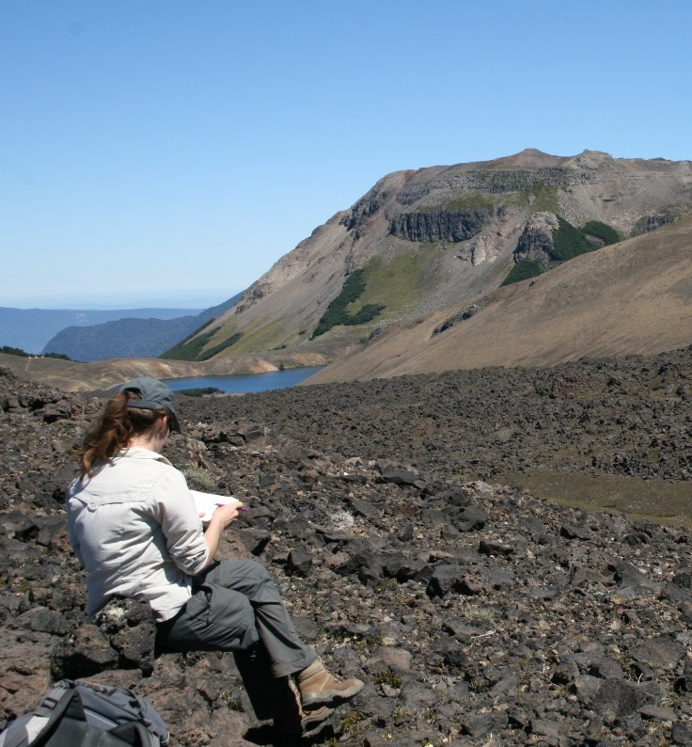
E5 DTP Applicants Support Webpages
Application deadline is 6th January 2025 for entry in September 2025
Frequently Asked Questions on each stage of our recruitment process (project choice, application, shortlisting, interview, offer)
Tips from current students about their applicant journey: how they chose their project, how they prepared their application and interview and how they finally made the decision to come to Edinburgh
External resources to help you prepare your CV and statements
Online Applicants Information and FAQs sessions (recording)

Slide 26
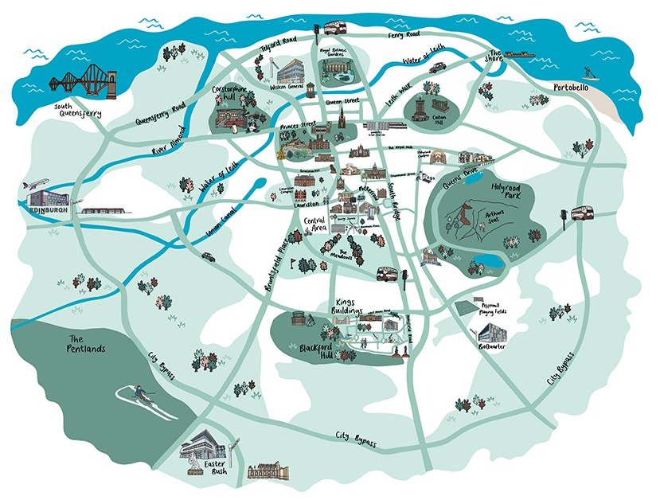

More information on studying at UoE
Campus Virtual Visits
Chat with UoE students
Notes:
You might be wondering what your next step should be after this presentation.
I’d encourage you to visit our Virtual Visit website, where you can explore the university or take our guided tour to see what it's like to live and study at the University of Edinburgh. Through the Virtual Visit website you can also start a text chat to our student ambassadors.
Our Unibuddy feature gives you direct text access to current undergraduate and postgraduate students ambassadors. You can use the search tool to find current student profiles that align with your interests, hobbies, home country, and possibly even academic interest. We continue to recruit more ambassadors but we’re sure you’ll find the current ambassador’s experiences really useful! And if you just want to skip the virtual tour and jump immediately to talking to students, you can use the second link that is here on the screen.

Slide 27
E5 DTP Admissions Team Nicola Drago Ferrante Cris Blyth
Annual University Closure from 23rd December 5pm to 3rd January 9am GMT. E5 DTP Admission team unavailable (no inbox monitoring).
Application deadline: 6th January 2025 –
12 Noon GMT
e5dtp.info@ed.ac.uk
Good luck with your application!

